Slide 1
Edge-Based Speech Transcription and Synthesis for Kinyarwanda and Swahili Languages
Group 7 Team Members:
Pacome Simon Mbonimpa
Natasha Mutangana
Diane Tuyizere

Slide 2
Introduction
Speech transcription and synthesis models play an important role in a variety of applications.
State of the art
Speech Transcription/Speech-to-Text
DeepSpeech achieved a 16.0% error on the Switchboard Hub5’00 corpus [1].
Wav2Vec demonstrated the feasibility of speech recognition with limited amounts of labeled data [2].
Whisper enabled transcription in multiple languages, as well as translation from those languages into English [3].
Speech Synthesis/Text-to-Speech
WaveNet was the first model that successfully modeled the raw waveform of the audio signal instead of the acoustic features [4].
FastSpeech pushed the limits of neural text-to-speech by offering significant improvement in inference speed while maintaining robustness to prevent word repetition or omission [5].
Tacotron2 [6] and SpeechT5 [7]

Slide 3
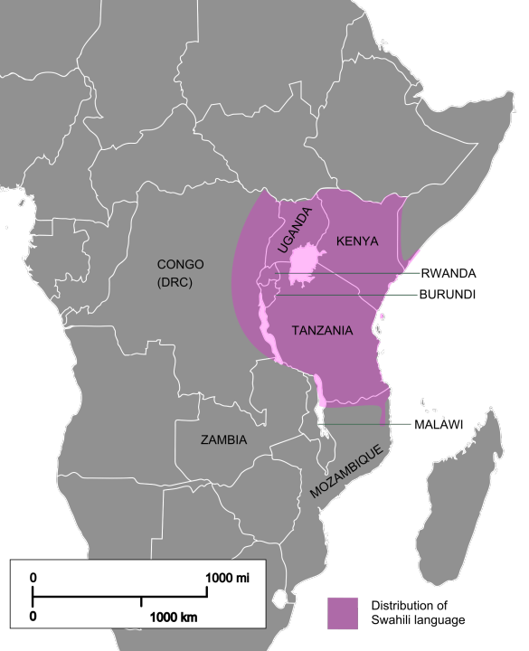
Problem
There is a significant scarcity of speech transcription and synthesis models for East African languages.
Many people in East Africa have very little access to the Internet and possess devices with constrained computation.

Slide 4
Proposed solution
Develop speech transcription and synthesis models for the Swahili and Kinyarwanda languages. (Swahili is the most spoken language in EAC ~ 150 million [8] and ~24 million people speak Kinyarwanda [9])
Introduce an edge-based system that leverages the Cascading Network architecture to process speech data on local devices efficiently and escalate to cloud-based resources when necessary.
Deploy these models on an edge device by incorporating speech-to-text and text-to-speech functionality for enhanced accessibility and usability.

Slide 5
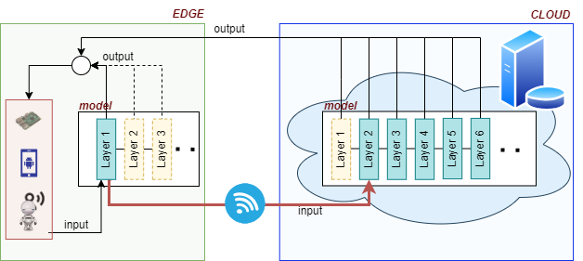
What is Cascading Networks?
The network begins processing on the constrained device and only relies on the remote part when the local part does not provide an accurate enough result.

Slide 6

Dataset
Open source data from Hugging face:
Mozilla Common Voice dataset for Kinyarwanda and Swahili.(For ASR and TTS)
- Training:16000
- Testing:15987
Open Bible Swahili(Genesis clean)(For TTS)
- Dataset: 1498

Slide 7
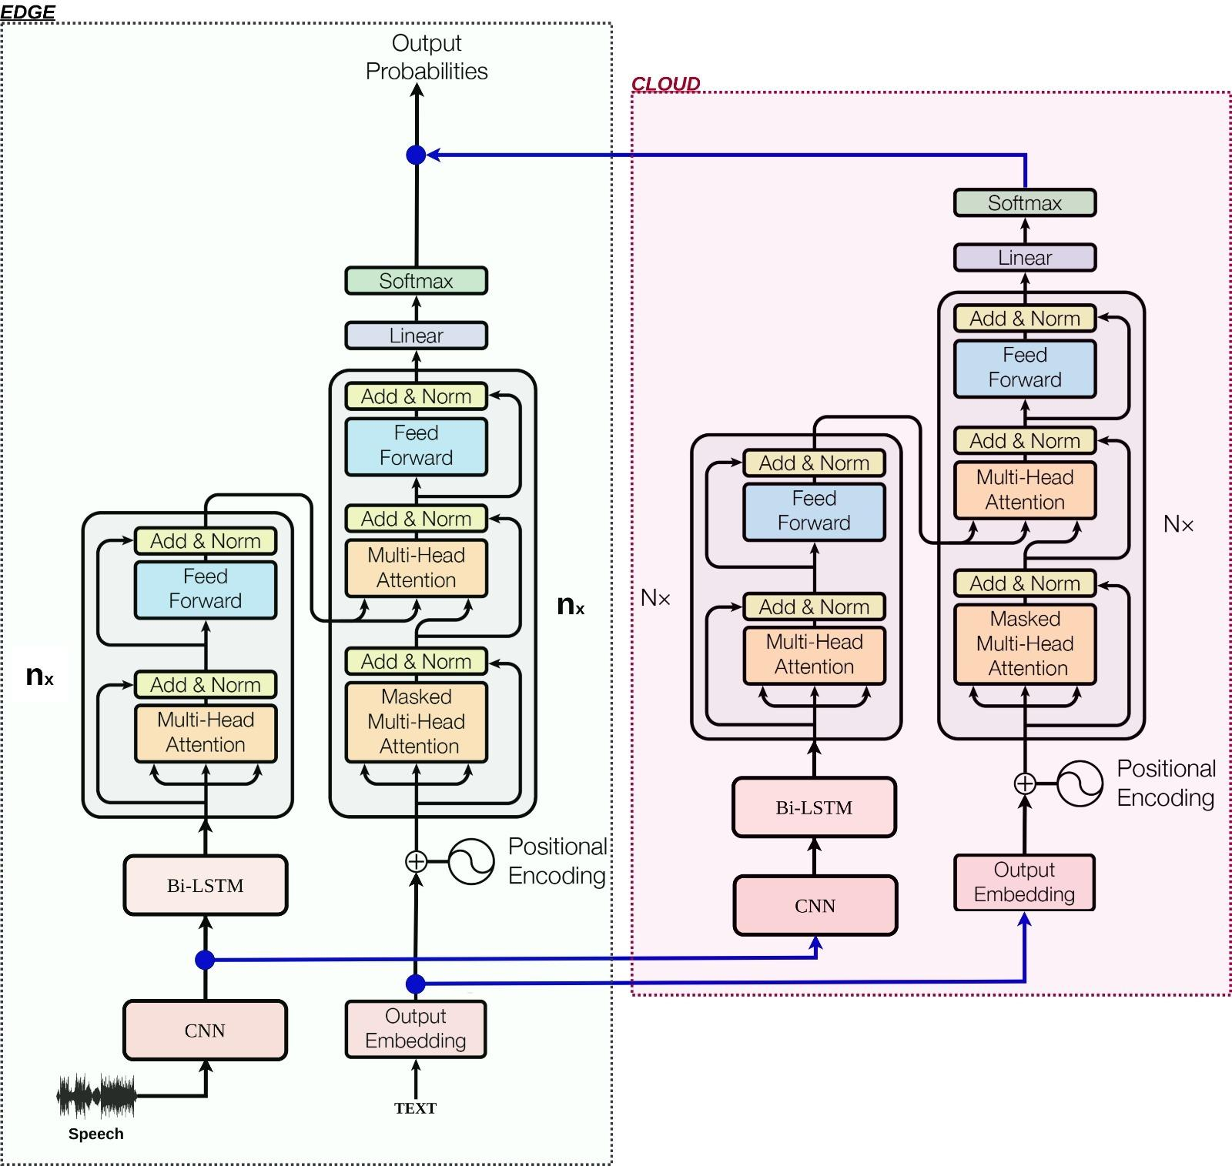
Cascaded STT model architecture Speech-To-Text
On the left, an edge-level architecture with nx layers initially computed and produces output.
When the output probabilities do not meet the set threshold?
The initially computed representation of the input speech at the CNN level as well as its corresponding embedding representations are sent to the cloud for further processing.

Slide 8
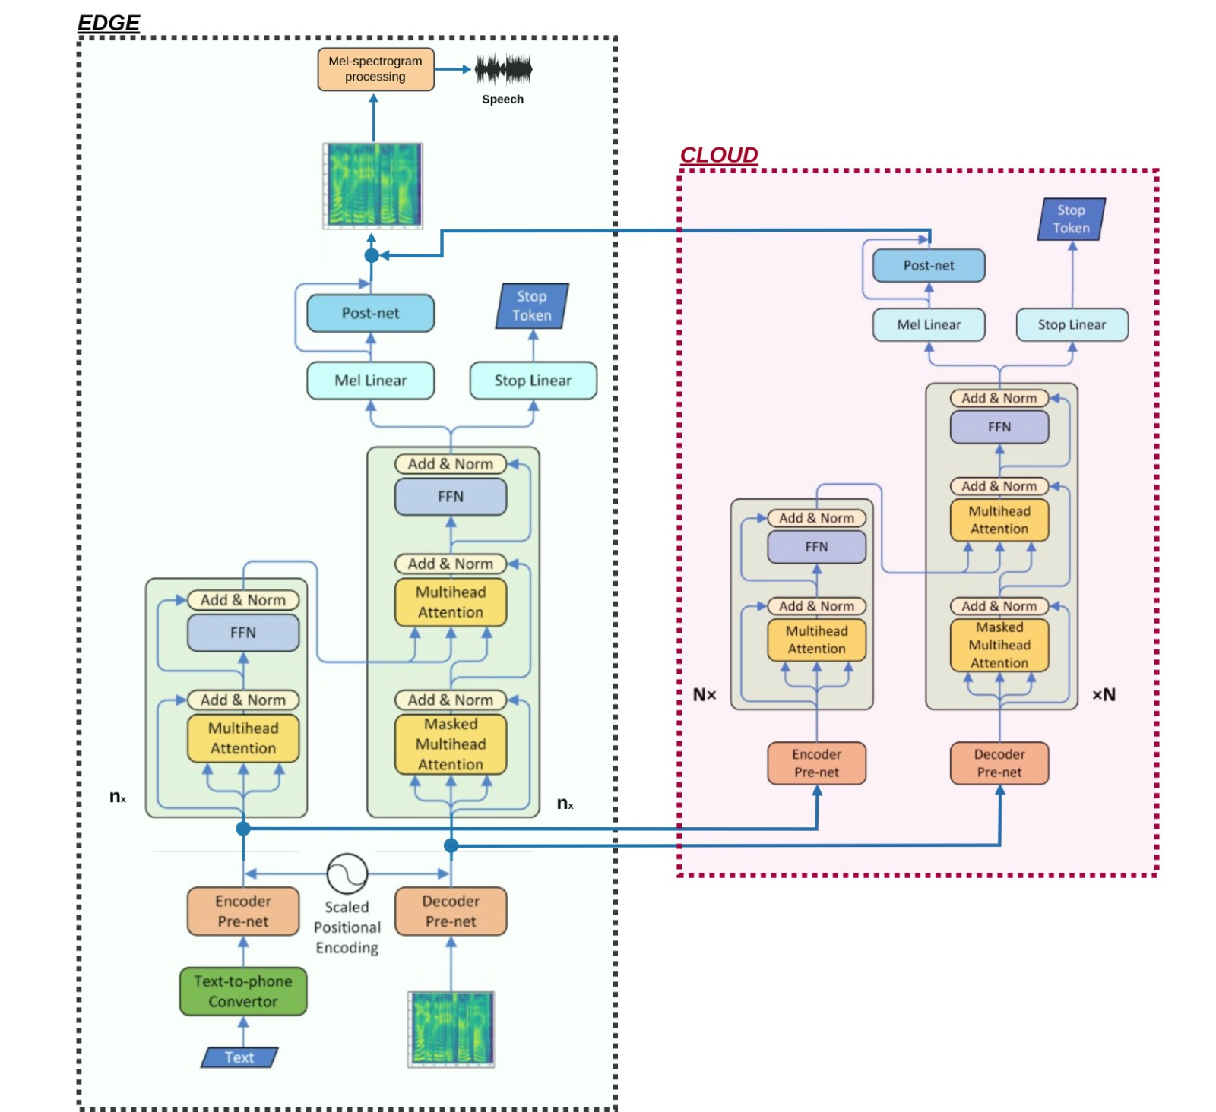
B. Cascaded TTS model architecture Text-To-Speech
On the left, an edge-level architecture with nx layers to be initially computed and produces output.
When the output noise in the audio exceeds the threshold?
The initially computed input text representation after the speech embedding as well as its corresponding speech representations are sent to the cloud for further processing.

Slide 9
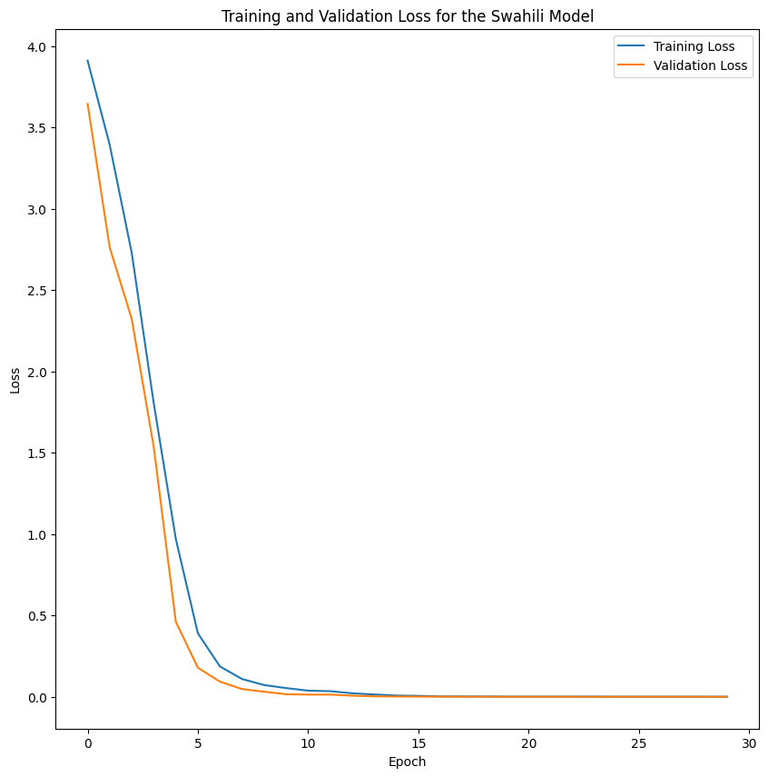
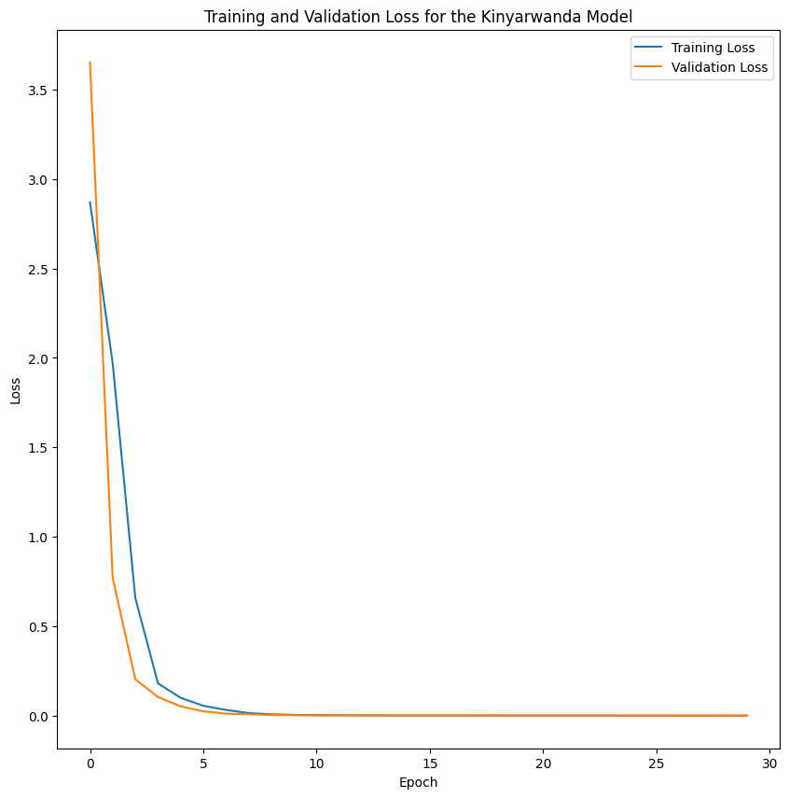
Experiments and Results - New Models (STT)

Slide 10
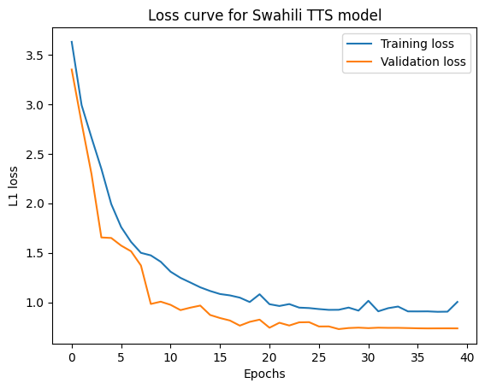
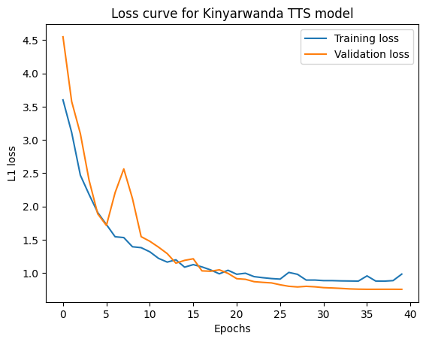
Experiments and Results - New Models (TTS)

Slide 11
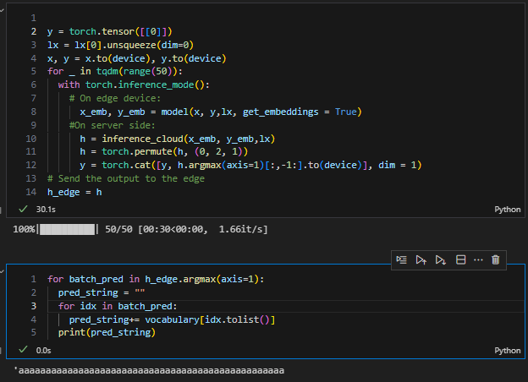
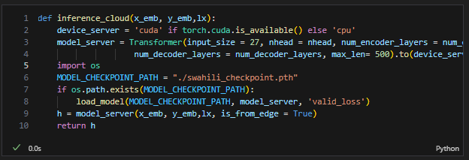
Code Example: Inference on a Deployed STT Model
On Edge (Client-side)
On Cloud (Server-side)

Slide 12
Experiments and Results - Fine Tuned Models (ASR-Whisper)
Swahili ASR (Demo) - 11 hours of training
Kinyarwanda ASR (Demo) - 11 hours of training
Step | Training Loss | Validation Loss | Wer
1000 | 0.379700 | 0.602877 | 40.236108
2000 | 0.112900 | 0.588555 | 35.584063
3000 | 0.050700 | 0.639749 | 35.440375
4000 | 0.016100 | 0.682069 | 34.943789
Step | Training Loss | Validation Loss | Wer
1000 | 0.695200 | 0.991951 | 70.502285
2000 | 0.477100 | 0.926026 | 68.362372
3000 | 0.313200 | 0.950552 | 68.073194
4000 | 0.202500 | 0.991832 | 68.727057

Slide 13
Experiments and Results - Fine Tuned Models (TTS-SpeechT5)
Swahili TTS
Kinyarwanda TTS
Step | Training Loss | Validation Loss
1000 | 0.598900 | 0.553199
2000 | 0.564900 | 0.534779
3000 | 0.562600 | 0.526816
4000 | 0.556600 | 0.523976
Step | Training Loss | Validation Loss
1000 | 0.563300 | 0.512955
2000 | 0.546400 | 0.507540
3000 | 0.533600 | 0.498774
4000 | 0.533400 | 0.497876

Slide 14
Challenges and Limitations.
Cascading architecture requires high bandwidth for edge to cloud connection.
Determining (by experimentation) the event that triggers the need to escalate the task to the cloud.
Training: small dataset, due to available resources.

Slide 15
Conclusion and Future Work
We introduce a novel approach for edge-based speech transcription and synthesis: the cascading network architecture.
The system processes speech data on edge devices, and provides a computational efficient way of escalating to cloud-based resources, when necessary.
Potential challenge: network bandwidth
Future work:
- Determining the escalation trigger.
- Determining suitable data compression for communication.
- Further training, using a bigger dataset.

Slide 16
References
[1]A. Hannun et al., “Deep Speech: Scaling up end-to-end speech recognition,” arXiv:1412.5567 [cs], Dec. 2014, Available: https://arxiv.org/abs/1412.5567
[2]A. Baevski, H. Zhou, A. Mohamed, and M. Auli, “wav2vec 2.0: A Framework for Self-Supervised Learning of Speech Representations.” Available: https://arxiv.org/pdf/2006.11477.pdf
[3]A. Radford, J. Kim, T. Xu, G. Brockman, C. Mcleavey, and I. Sutskever, “Robust Speech Recognition via Large-Scale Weak Supervision.” Available: https://cdn.openai.com/papers/whisper.pdf
[4]A. Van Den Oord et al., “WAVENET: A GENERATIVE MODEL FOR RAW AUDIO,” 2016. Available: https://arxiv.org/pdf/1609.03499.pdf
[5]Y. Ren et al., “FastSpeech: Fast, Robust and Controllable Text to Speech,” arXiv:1905.09263 [cs, eess], Nov. 2019, Available: https://arxiv.org/abs/1905.09263
[6]J. Shen et al., “NATURAL TTS SYNTHESIS BY CONDITIONING WAVENET ON MEL SPECTROGRAM PREDICTIONS.” Available: https://arxiv.org/pdf/1712.05884.pdf
[7]J. Ao et al., “SpeechT5: Unified-Modal Encoder-Decoder Pre-Training for Spoken Language Processing.” Available: https://arxiv.org/pdf/2110.07205.pdf

Slide 17
References
[8]“Swahili | Critical Languages Program | College of Humanities,” clp.arizona.edu. https://clp.arizona.edu/courses/languages/swahili
[9]“Rwanda’s population reaches 13,2 million in 2022 | National Institute of Statistics Rwanda,” www.statistics.gov.rw. https://www.statistics.gov.rw/publication/Rwanda_population_2022
[10]OpenAI, “Whisper,” GitHub, Oct. 09, 2022. https://github.com/openai/whisper

Slide 18
THANK YOU!

